Slide 1
Discipline at the Company Level
LEADERSHIP III FOR FIRE AND EMS: STRATEGIES FOR SUPERVISORY SUCCESS

Slide 2
OBJECTIVES
The students will:
Identify the value of positive discipline.
Describe how to use discipline to correct improper employee behavior.
Describe how to apply discipline consistently, fairly, and impartially.
Identify the value of progressive discipline.

Slide 3
OVERVIEW
Introduction
Positive and Negative Discipline
Rules and Regulations
The Importance of Discipline
Common Violations and Actions
Progressive Discipline
The Disciplinary Interview
Bizarre Behaviors
Employee Values
Final Tips

Slide 4
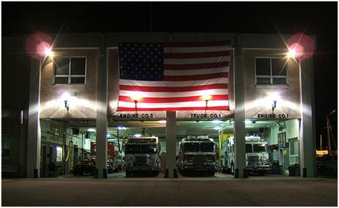
Introduction
The perfect fire department/emergency medical services (EMS):
  Perfect set of rules.
  Management support.
  Employees know appeal
  procedures.
  Rules enforced.
  Transferring of problem personnel
  at the first opportunity never occurs.
  Company Officers (COs) trained in discipline.

Slide 5
Introduction (cont'd)
Difficulties
  Inappropriate/Obsolete rules
  Unsupportive administration
  Reductions in severity when appealed
  Some officers who do not enforce rules
  Transferring problem personnel
  Untrained

Slide 6
Introduction (cont'd)
Definition
  Discipline is behavior and order maintained by training and control.
  A disciplinary system spells out specific punishments for specific infractions.

Slide 7
Activity DP.1
Reasons Discipline Is Avoided

Slide 8
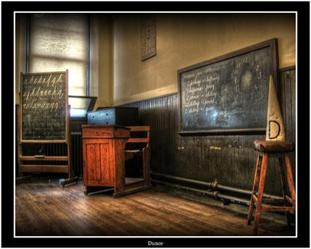
Positive and Negative Discipline
Negative discipline involves:
  Punishment, often harsh
  Win-lose climates
  Interpersonal resentment

Slide 9

Positive and Negative Discipline (cont'd)
Positive approach:
Encourages self-discipline
Disciplinary actions necessary to educate
Lets person know through experience and example what is expected
Aimed at guiding the member
Mildest penalty causing change
Attitude that must be accepted by supervisor as approach and developed in subordinate

Slide 10
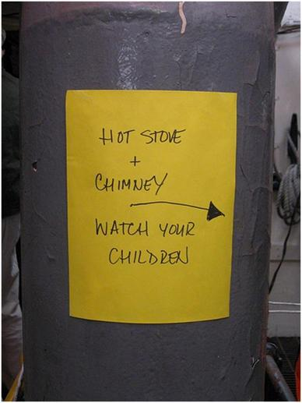
Rules and Regulations
"Hot stove" theory
  Gives you warning
  Reacts immediately
  Consistent
  Impersonal
  Doesn't apologize or gloat
  Doesn't get emotional

Slide 11
Rules and Regulations (cont'd)
Rules are key to effective discipline if:
  Thoroughly understood and communicated
  Applied equally
  Enforced
  Written
  Needed

Slide 12
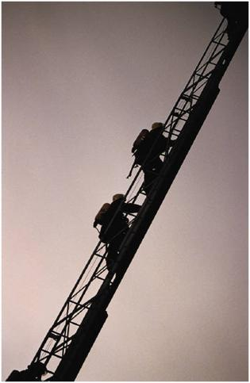
Rules and Regulations (cont'd)
Failure to follow rules can endanger others.
Rules should be reviewed periodically.
  Obsolete rules can cause disrespect.
  Obsolete rules weaken control and morale.
  COs should work toward changing unfair or obsolete rules.

Slide 13
The Importance of Discipline
To the department
  Enhances organizational efficiency and effectiveness
  Reinforces departmental values
  Reinforces hierarchical relationships
  Fosters order, not chaos
  Clarifies management's expectations of subordinates
  Resolve problems at an early stage
  Reduces organizational liability

Slide 14
The Importance of Discipline (cont'd)
To the CO
  Provides tools to deal with improper behavior
  Increases company efficiency
  Provides framework for equitable and fair treatment
  Authority to discipline contributes to CO's powerbase
  Earns respect
  Improves individual subordinate's performance
  Increase self-discipline

Slide 15
The Importance of Discipline (cont'd)
To the firefighter/EMT
  Provides a certain level of security
  Set boundaries
  Makes organizational goals clear
  Rewards employees for good behaviors
  Corrects problems before it's too late

Slide 16
The Importance of Discipline (cont'd)
Bureaucracy ensures fair treatment for all employees by management.
  Each employee has specified and official areas of responsibility controlled by rules.
  There is a clearly ordered system of supervision and subordination.
  Written rules are maintained as a means of managing.

Slide 17

What are the most common disciplinary problems in a career department?

Slide 18
Common Violations and Actions
Tardiness
Absenteeism
Abuse of sick leave
Insubordination
Missed alarms
Failure to carry out assignments
Sloppy work
Sloppy appearance
Improper conduct
Failure to adequately perform at emergencies

Slide 19
What are the most common disciplinary problems in volunteer departments?

Slide 20
Common Violations and Actions (cont'd)
Poor attendance at emergencies
Poor attendance at training
Poor participation at other departmental functions
Poor performance at emergencies
Driving private vehicles recklessly while responding to alarms
  Responding to alarms while under the influence of alcohol or drugs
  Fighting
  Improper care of equipment
  Failure to use proper personal protective equipment (PPE) at emergency scenes
  Insubordination

Slide 21
What are the similarities and differences between disciplinary problems encountered in career and volunteer departments?

Slide 22
Common Violations and Actions (cont'd)
Common disciplinary actions
  Informal discussion is first option
  Verbal warning or admonishment
    -- Usually first attempt to correct minor violations
    -- Gives employee a chance to correct behavior without a permanent entry in the official record

Slide 23
Common Violations and Actions (cont'd)
Written reprimand
  An official action for failure to correct behavior after one or two verbal warnings
  Sometimes the initial discipline for more serious violations of rules and procedures
  Usually part of employee's official record
  Usually recommended by the CO and acted on by the fire/EMS chief

Slide 24

Common Violations and Actions (cont'd)
Fine
  Forfeiture of pay
  Forfeiture of time
  Demotion (if appropriate)
  Extra work during the regular duty day
  Small fines sometimes used in volunteer organizations
  Usually recommended by the CO and acted on by the fire/EMS chief

Slide 25
Common Violations and Actions (cont'd)
Suspension
  Given for repeated violations
  Given initially for serious violations
  Last step before termination
  Usually from 1 to 30 days in length
  Usually recommended by the CO and acted on by the fire/EMS chief

Slide 26
Common violations and actions (cont'd)
Demotion
  Temporarily
  Permanently

Slide 27
Common Violations and Actions (cont'd)
Termination
  After all else fails
  Used only if employee cannot be rehabilitated or made to conform to departmental standards or if public safety or health is endangered
  Usually recommended by the CO and acted on by the fire/EMS chief

Slide 28
Progressive Discipline
A positive corrective plan, rather than a negative approach
Proposed punishment should:
  Be reasonable
  Fit the offense
  Become increasingly severe for repeated infractions of the same rule
Process that has greatest potential to correct improper behavior with minimal punishment

Slide 29
Progressive Discipline (cont'd)
Value:
  Minimum punishment
  Fair
  Required to implement more severe punishment if previous failed
  Vital for successful outcome if action is appealed
  Gives employees a chance to show they can meet job standards

Slide 30
Progressive Discipline (cont'd)
Progressive discipline versus "zapping" approach
  "Zapping" takes place when you have a marginal employee who is barely performing, yet you're never able to pinpoint a specific punishable offense. Eventually, the employee does something which is punishable and you "zap" with a punishment much greater than is warranted for the specific violation

Slide 31
Progressive Discipline (cont'd)
Progressive discipline versus "zapping" approach (cont'd):
  "Zapping" is usually an attempt to "get" the employee for all past, unpunished behavior.
  Usually overturned upon appeal because punishment doesn't fit infraction
-- Also referred to as "Gunny Sacking"
COs need to ask themselves two questions in such situations:
  Does proposed discipline fit the present violation
  Is proposed discipline likely to correct behavior

Slide 32
Typical Actions Chart
Offense | First Offense Discipline | Second Offense Discipline | Third Offense Discipline
Tardiness | Verbal warning | Reprimand | Suspension (progressive)
Insubordination | Suspension | Termination
Missed alarm | Warning/ Suspension | Suspension | Termination
Sloppy work | Warning | Reprimand/ Suspension | Suspension/ Termination
Improper conduct | Warning/ Suspension | Reprimand/ Suspension | Termination
Violation of safety regulations | Warning | Reprimand/ Suspension | Suspension/ Termination
Stealing | Suspension/ Termination | Termination
Fighting | Suspension/ Termination | Termination

Slide 33
Typical Actions Chart (cont'd)
Considerations when applying progressive discipline
  Prior violations of similar rules
  Extenuating circumstances--supervisor must always be fair and impartial
  Seriousness of the offense

Slide 34
The Disciplinary Interview
Steps in conducting disciplinary interview
  Prepare
  State your case
  Indicate seriousness
  State expectations
  Try to get commitment change from employee
  End session on positive note
  Document your actions
  Inform employee of appeal procedures

Slide 35
The Disciplinary Interview (cont'd)
Checklist for successful disciplinary interview
  Select proper setting
  Listen
  Don't interrupt
  Don't lose your temper
  Don't argue
  Stick to the facts
  Focus on specific improper behavior

Slide 36
The Disciplinary Interview (cont'd)
Common errors:
  Not being clear about violations.
    -- Is not fair to employee.
    -- Will not succeed in correcting improper behavior.
    -- Can damage morale.
    -- Everyone is a loser.
  Improper or no documentation.
    -- Most cases lost on appeal are due to insufficient or improper documentation.
    -- Don't make idle threats.

Slide 37
Activity DP.2
Evaluating Disciplinary Processes

Slide 38
Bizarre Behaviors
Behaviors that are unusual in nature and for which there may not be written rules or procedures:
  Member shows up for work with large dangling earring and refuses to remove it.
  Member shouts abuses at a citizen walking by station.
  Member writes obscenities on restroom walls.
  Member preaches religious beliefs to owners while on code enforcement.
  Member(s) engage in horseplay or practical jokes.

Slide 39
Bizarre Behaviors (cont'd)
What is bizarre to one may be normal to another.
COs need to guard against overreacting.
Bizarre behavior checklist:
  Damage to equipment or property?
  Create unsafe situation?
  Correctable?
  Violate the law?
  Department's image damaged?
  Damage morale?

Slide 40
Bizarre Behaviors (cont'd)
As CO, you must deal with this type of behavior just as you do with routine disciplinary problems.
  Avoid inappropriate reactions.
  Make sure your normal procedures are followed.
  Advise employee of appeal procedures.

Slide 41
Bizarre Behaviors (cont'd)
If there is no specific rule in place, consult management. Management should:
  Determine policy
  Transmit policy
  Enforce new policy
  Continue disciplinary actions even if it is felt the actions will be reversed on appeal

Slide 42
Bizarre Behaviors (cont'd)
In many cases involving inexperienced supervisors or managers, termination is their primary reaction to any type of bizarre behavior. These inappropriate reactions are almost always lost when appealed.
The CO should seek advice from superiors when dealing with any type of bizarre behavior.

Slide 43
Employee Values
Wouldn't it be wonderful if all employees had:
  Proper attitude
  Willingness to work
  Commitment to departmental goals
They don't! There will always be some:
  Undisciplined personnel
  Incompetent personnel
  Personnel who won't do the work expected of them

Slide 44
Employee Values (cont'd)
Three types of subordinates:
  Employee with positive self-imposed discipline
  Employee with goals and values that don't match organization
  Will not adapt to department's goals and values

Slide 45
Employee Values (cont'd)
Don't ignore problems.
  Don't let improper behavior slide--take action.
  Be sure you inform employee that a rule has been violated as soon as it occurs.
Most marginal employees can be coached and motivated into becoming productive employees.

Slide 46
Activity DP.3
Determining Proper Discipline

Slide 47
Final Tips
Cardinal Rule #1: Praise in public; criticize in private.
Treat every case as if it will be appealed.
When discipline is given, it is over. Don't keep referring to someone's mistakes.
Apply discipline consistently, fairly, and impartially.
Deal with behavior, not personality.
Never discipline when you are angry.
Reinforce good behavior.
Set a good example.
Don't "save up" discipline--act as soon as possible.

Slide 48
Final Tips (cont'd)
Don't threaten punishment you cannot deliver.
If you suspect substance abuse, get help from chief's office.
If in doubt on any disciplinary action, ask the chief's office.
Don't play games with union by giving too much discipline, figuring it will be reduced when appealed.
Don't transfer your problems; solve them.
Be familiar with union contract's grievance procedures and employee rights.

Slide 49
Final Tips (cont'd)
Know your rules and regulations thoroughly
Be willing to treat an honest mistake as an honest mistake.

